Slide 1




Automatic identification of collocations
Ministère de l’Enseignement supérieur et de la Recherche scientifique Université de la Manouba Ecole Nationale des Sciences de l’Informatique
Realized by :
Rahma Akaichi
Abir Bel Haj Youssef
Academic Year : 2019/2020

Slide 2


CONCEPT & Problem Setting
01
03
Word Embedding
02
Pre-processing
04
Similarity and colocations checking
OVERVIEW
Conclusion & Perspects
05

Slide 3

Problem Setting and Concept
01

Slide 4


PROBLEM SETTING
Automatic translation , Information search , Part of speech tagging are few from NLP application widely spread for most reputed languages like french and English , but what about Arabic ?
2

Slide 5


CONCEPT
This projects aims at generating automate the identification of colocations within an Arabic context,

Slide 6
Pre-processing
02

Slide 7
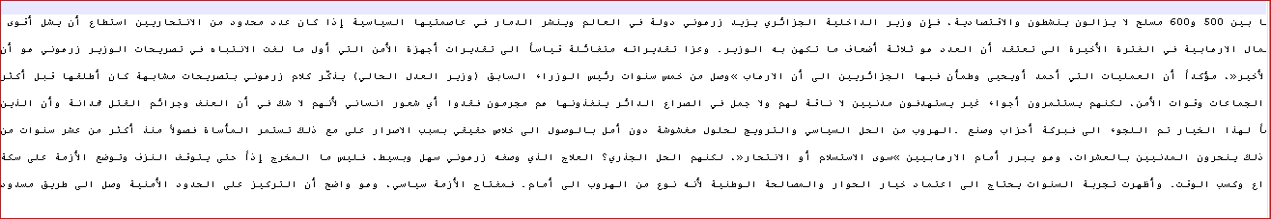
-unstructured Data
-lots of noise(punctuations , special characters)
Initial Data:

Slide 8
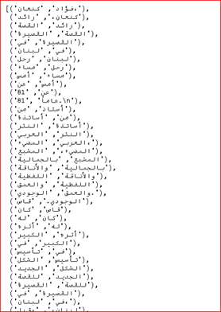
Getting bigrams from the corpus

Slide 9
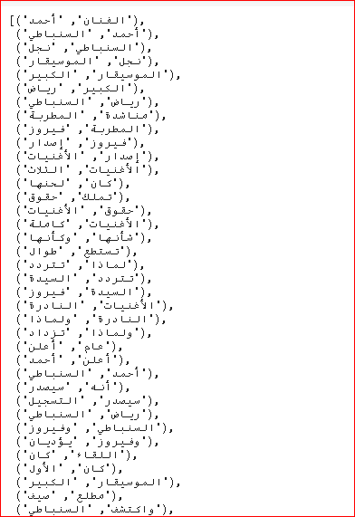
Stopwords and punctuation removing

Slide 10
03
Word Embedding

Slide 11
Word2Vec

Slide 12
Concept
Word2Vec is one of the most popular technique to learn word embeddings using shallow neural network. It was developed by Tomas Mikolov in 2013 at Google.

Slide 13
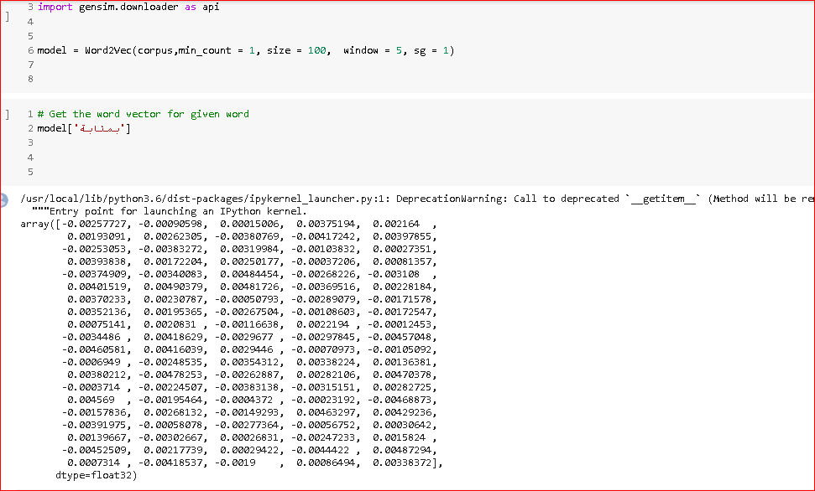
Getting the word vectors

Slide 14
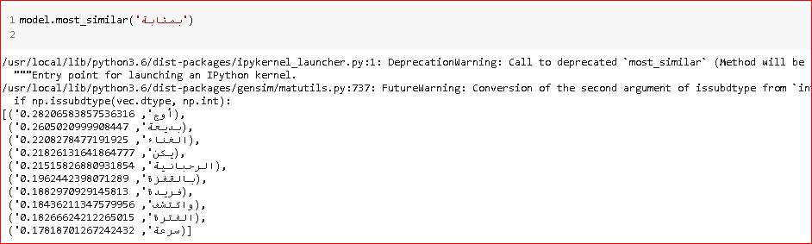
Figuring most similar words to a given word

Slide 15
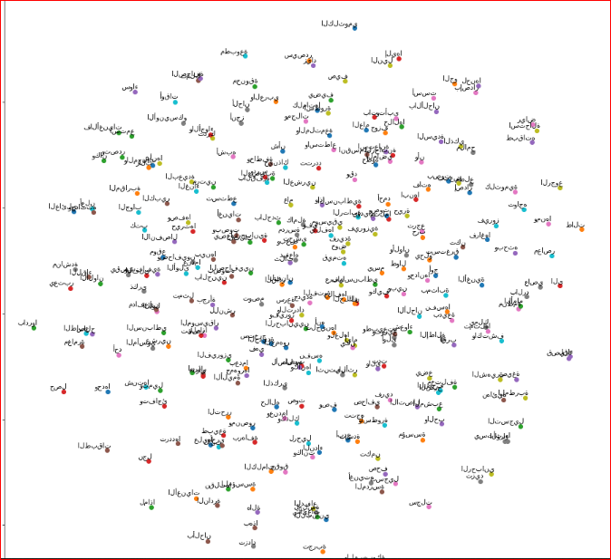
Visualizing words embeddings

Slide 16
FastText

Slide 17
Concept

Slide 18
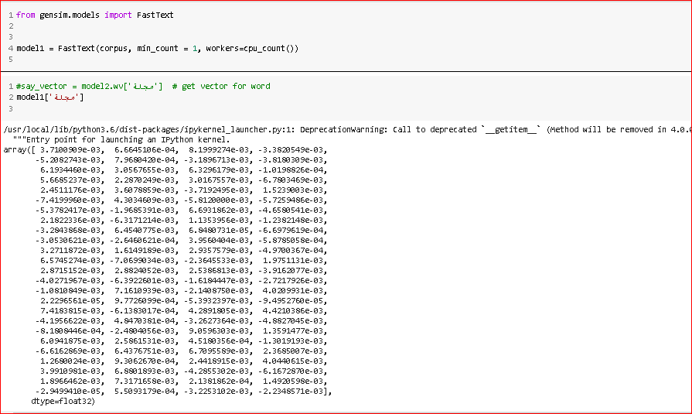
Getting the word vectors

Slide 19
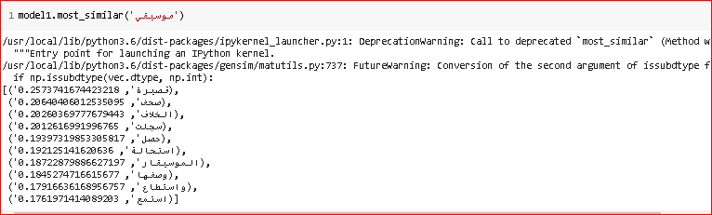
Figuring most similar words to a given word

Slide 20
04
Words Similarity and colocation identification

Slide 21
Word2Vec

Slide 22
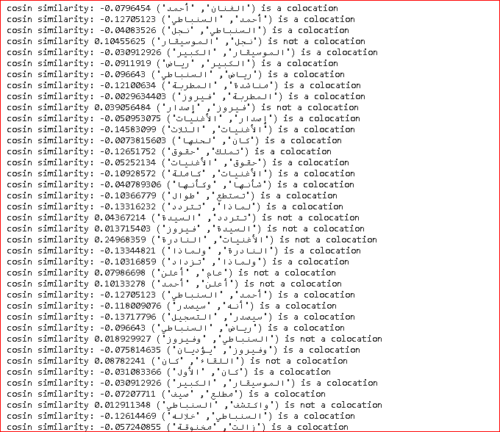
Follows the identification of colocations

Slide 23
FastText

Slide 24
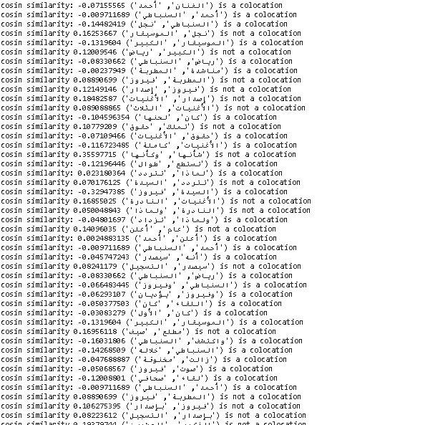
Follows the identification of colocations

Slide 25
Conclusion & perspects
05

Slide 26

WHAT have we done so far ?
Text-preprocessing
Word Embedding
Colocation Identification

Slide 27

Thanks for you attention!

